Slide 1
Tring international

Slide 2
Tring international
The channel brings the best selection of original productions by Tring Platform in since it launch. Entertainment with several seasons of the best shows, Albanian cinematography, magazines & TV formats created for the thematic channels of the only digital multimedia Albanian platform.
All in one channel for Albanians in the world: Europe, America and Australia, Tring International, Albanian productions of the house.

Slide 3
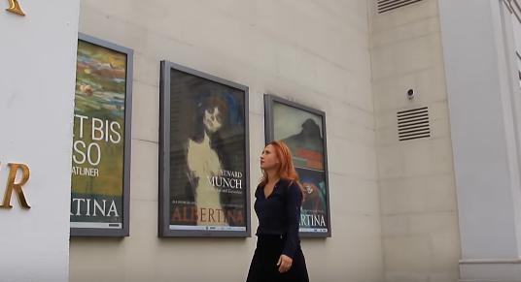
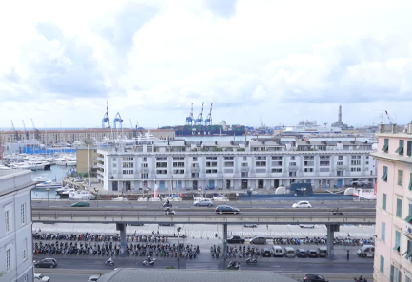
Broadcasting for each category
CULTURAL AND ARTISTIC DOCUMENTARY
EVERY DAY
19:00

Slide 4
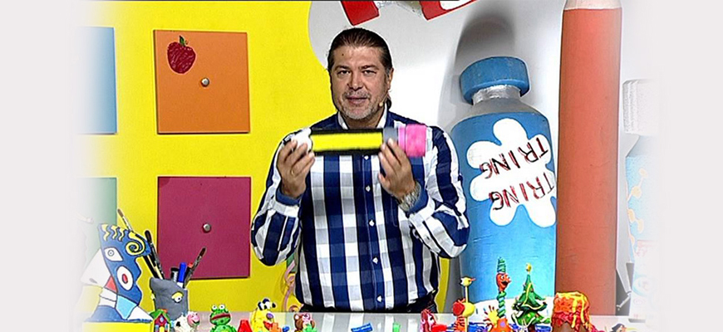
Broadcasting for each category
CHILDREN’S PROGRAM
EVERY DAY
18:00

Slide 5
Broadcasting for each category
MAGAZINES / LIFESTYLE / REPORTAGE
EVERY DAY
20:00

Slide 6
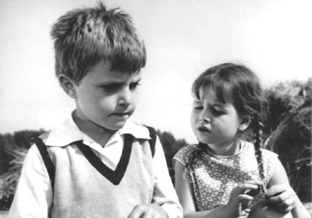
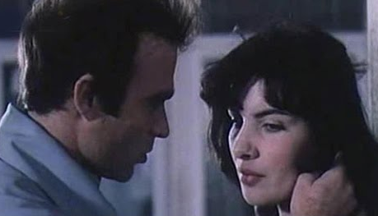
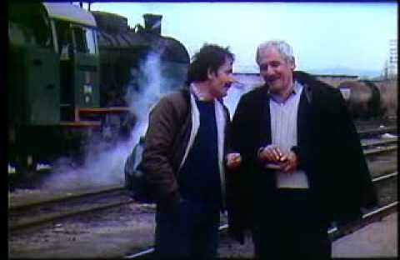
Broadcasting for each category
ALBANIAN CINEMATOGRAPHY
EVERY MONDAY AND TUESDAY
21:00

Slide 7
Broadcasting for each category
ENTERTAIMENT SHOW
EVERY WEDNESDAY
21:00

Slide 8
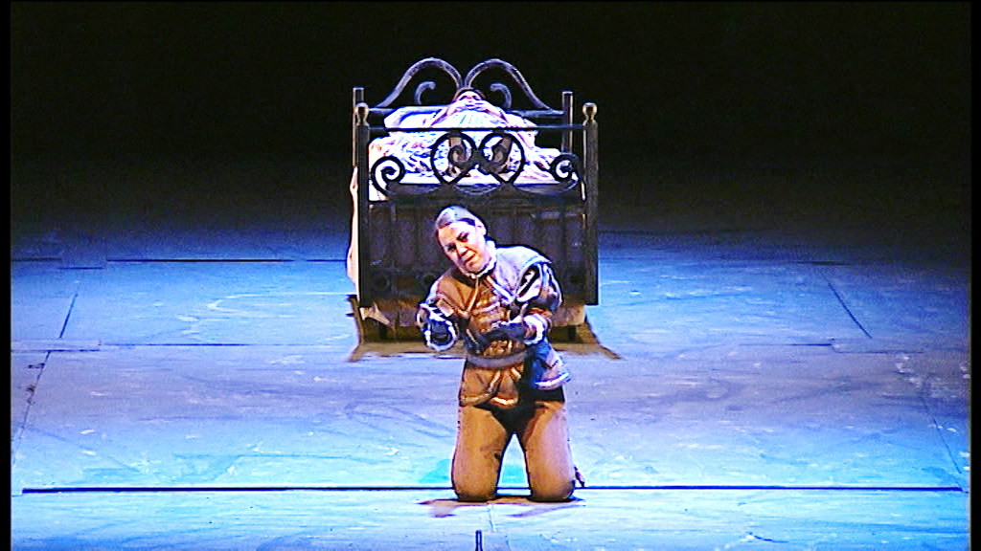
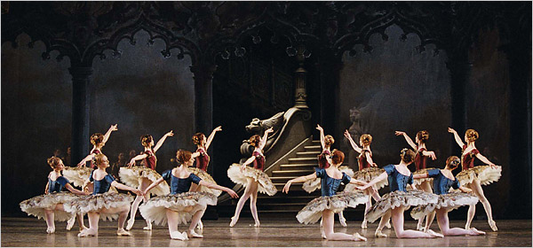
Broadcasting for each category
BALLET AND OPERA
EVERY THURSDAY
21:00

Slide 9
Broadcasting for each category
THEATRE
EVERY FRIDAY
21:00

Slide 10
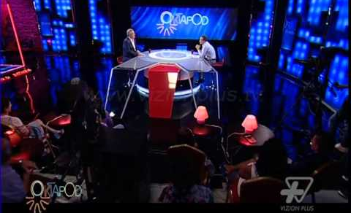
Broadcasting for each category
TALK SHOW
EVERY SATURDAY
21:00

Slide 11
AND MORE SHOWS…
The channel WILL bring to you the best selection of original productions of Tring Platform in 8 years of history.

